Slide 1
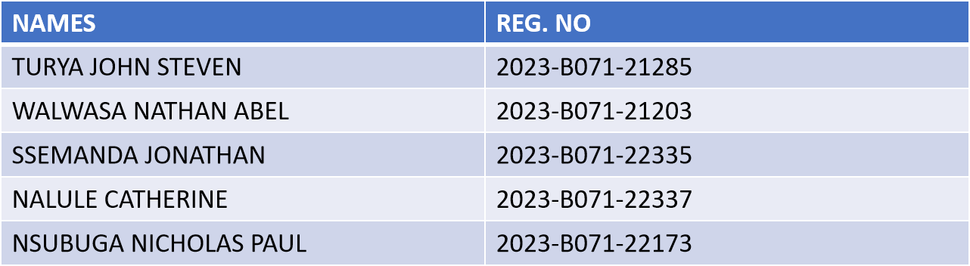
Twitter brand sentiment analysis
Group 2

Slide 2
overview
Objective. To analyze sentiment towards various brands based on Twitter data, identify key trends, and build a predictive model for sentiment classification.
Dataset.
Total Tweets Analyzed: 75,682 (combined training and validation sets).
Unique Brands: 32.
Sentiment Categories. Positive, Negative, Neutral, Irrelevant.
Methodology.
Data Cleaning: Preprocessing tweet text to remove noise (URLs, mentions, etc.).
Sentiment Analysis: Applied TextBlob and VADER to assign sentiment scores.
Feature Engineering: Created TF-IDF features to identify important keywords.
Trend Analysis: Analyzed sentiment fluctuations over time and detected significant spikes.
Modeling: Trained a Logistic Regression model to classify tweet sentiment.
Key Insights. The analysis provides a comprehensive view of public opinion on major brands, highlighting periods of significant positive or negative sentiment and the topics driving these conversations.

Slide 3
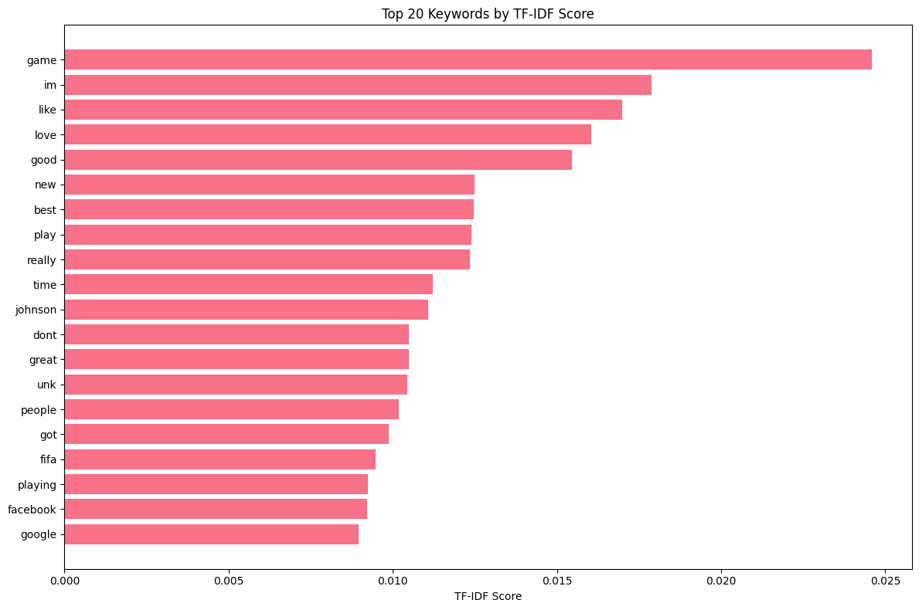
Top 20 Keywords by TF-IDF Score

Slide 4
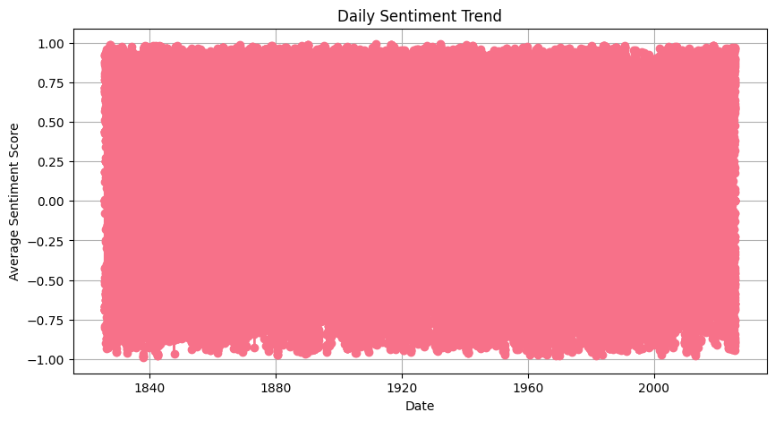
Daily sentiment trend

Slide 5
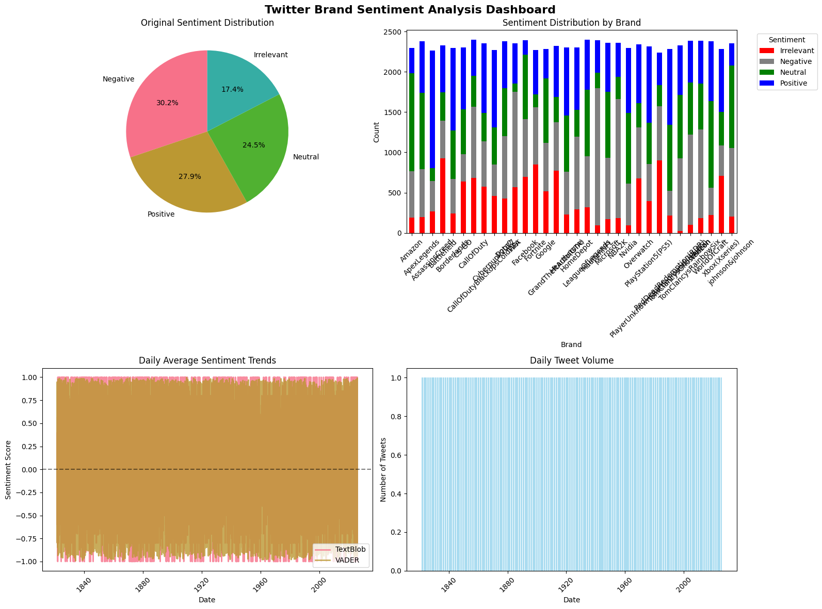
Sentiment Analysis

Slide 6
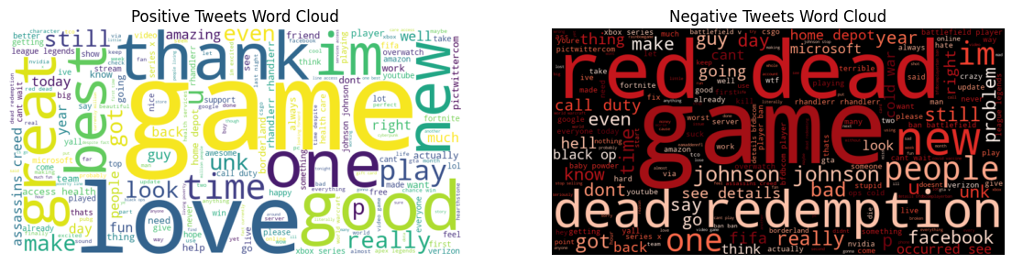
Word Clouds by Sentiment

Slide 7
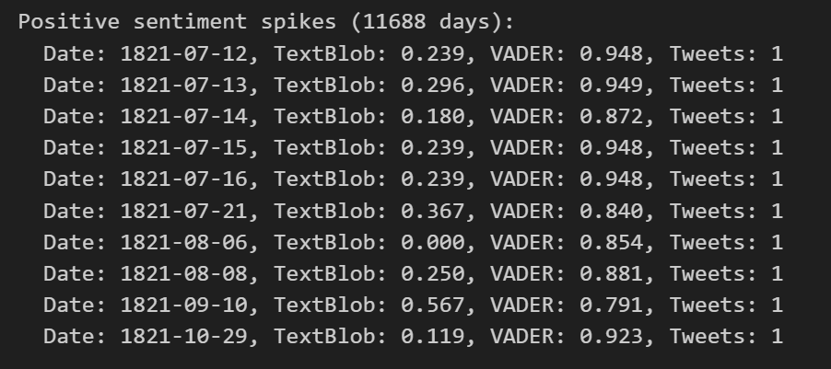
Positive sentiment spikes

Slide 8
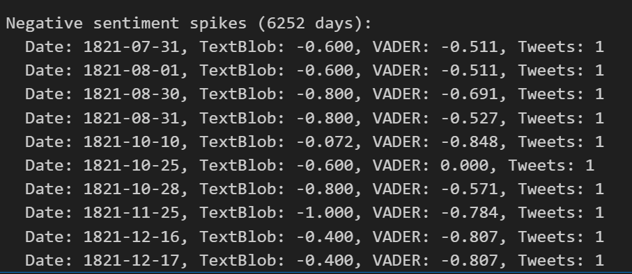
Negative sentiment spikes

Slide 9
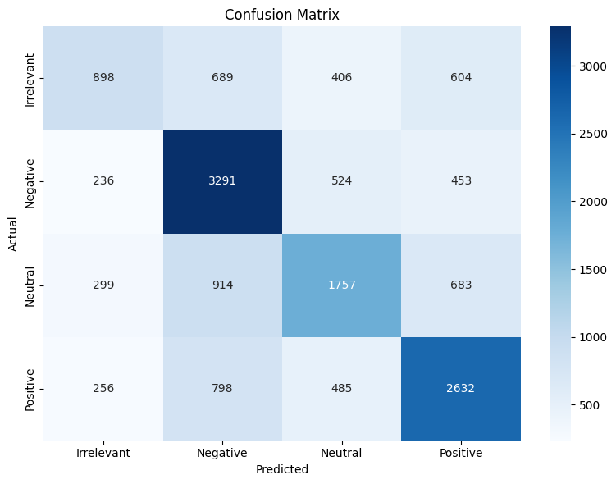
Machine Learning Model Performance (Confusion Matrix)

Slide 10
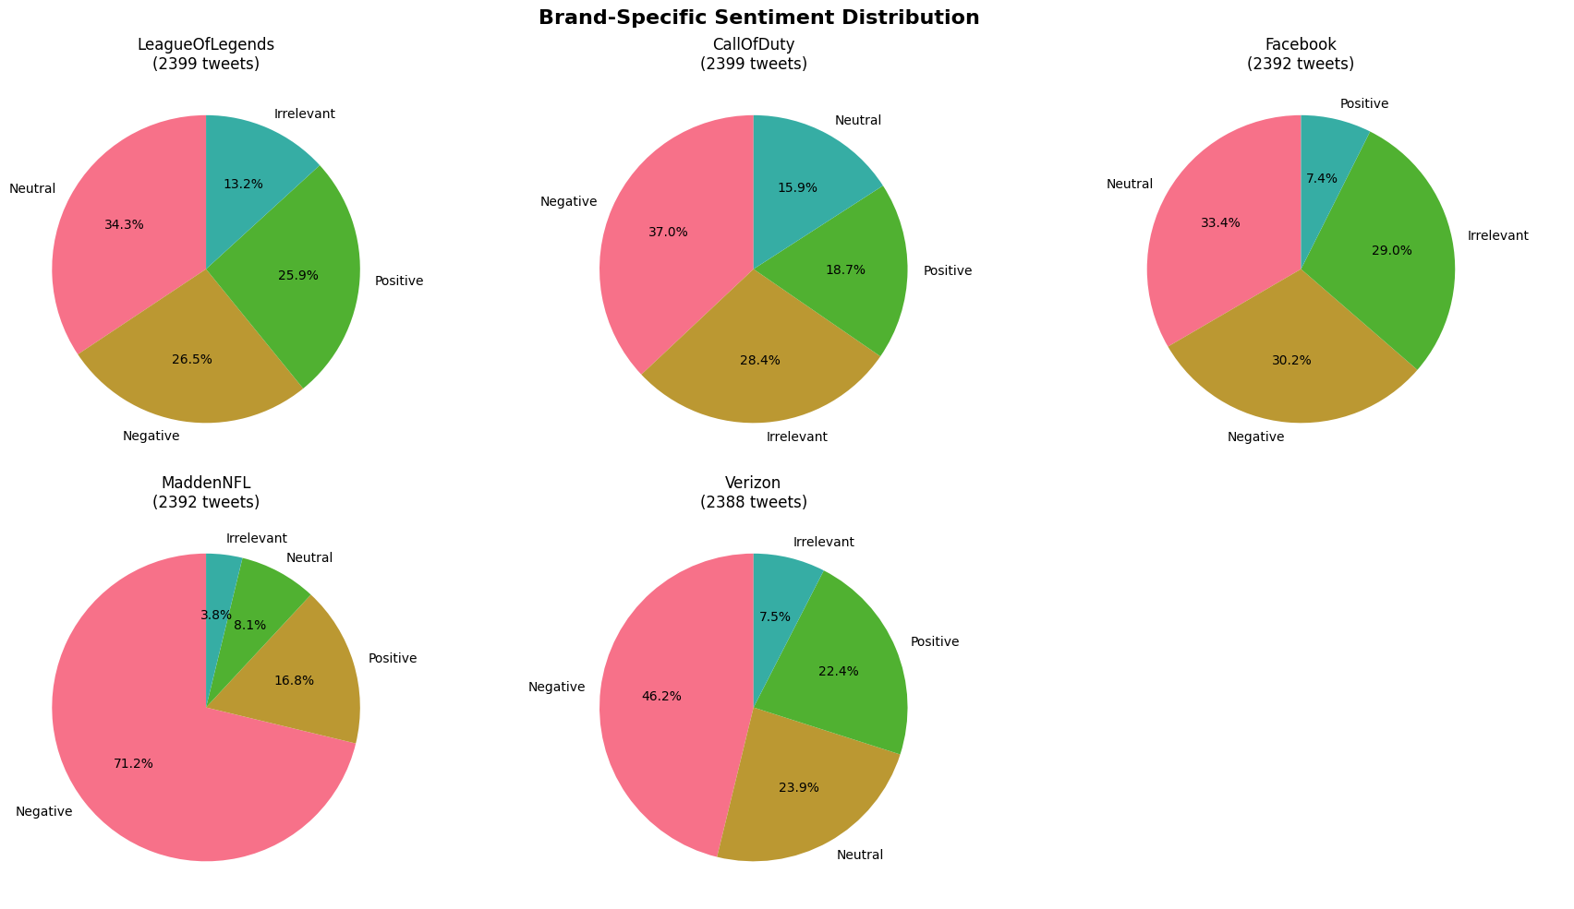
Deep Dive: Brand-Specific Sentiment Brand-Specific Sentiment Distribution

Slide 11
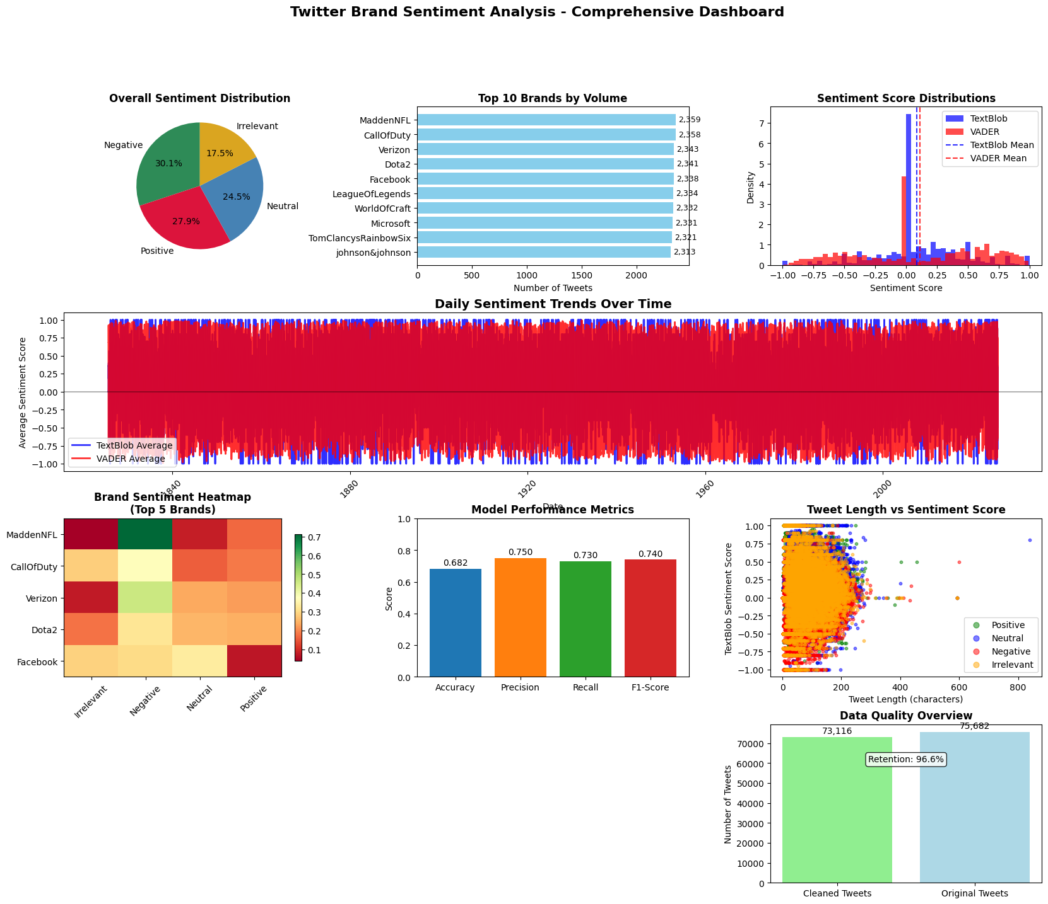
Twitter brand sentiment analysis

